Slide 1
Stop the spread of infection
Cleaning For Health In The Face of A Global Pandemic

Slide 2
Objectives
Overview
What is COVID-19?
How Does it Spread?
Prevention Ideas
Clean & Disinfect
Product solutions
Proper Hand Hygiene
Educational Resources

Slide 3
What to Know
COVID-19
Coronaviruses are a large family of viruses which may cause illness in animals or humans. In humans, several coronaviruses are known to cause respiratory infections ranging from the common cold to more severe diseases such as Middle East Respiratory Syndrome (MERS) and Severe Acute Respiratory Syndrome (SARS). The most recently discovered coronavirus, SARS-CoV-2, causes the 2019 novel coronavirus disease, also known as COVID-19.

Slide 4
How does it spread
Covid-19
People can catch COVID-19 from others who have the virus via person to person transmission.
As of March 26, 2020 there are over 68,500 confirmed cases of COVID-19 and 1,036 deaths in the United States of America.
Person-to-Person Contact
The most common transmission of all Coronaviruses is Airborne via respiratory droplets.
The second most common transmission is through Close Contact with an infected person (shaking hands or within 6 feet of person)
SARS-CoV-2 may possibly be transmitted by contacting a Contaminated Surface and then rubbing your eyes, ears, nose, or mouth, though this has not been documented.
Refer to the CDC website https://www.cdc.gov/coronavirus/2019-ncov/index.html for additional information.

Slide 5
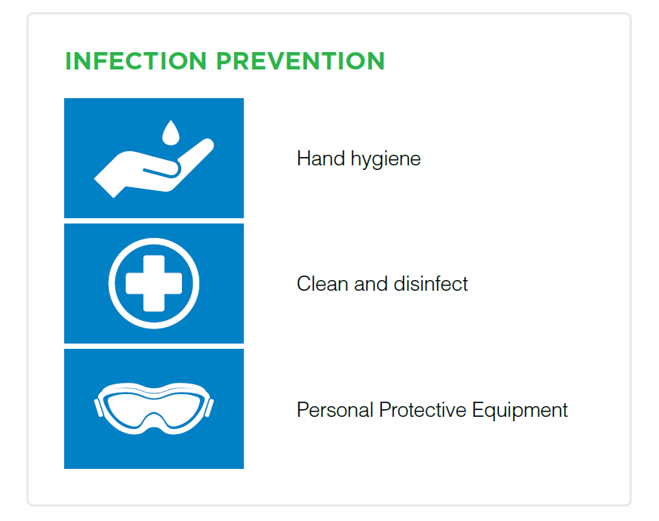
What we can do
Protection Measures
Stay aware of the latest information on the COVID-19 outbreak
Take care of your health and protect others by doing the following:
Wash your hands regularly – using a handwash or hand sanitizer
Maintain at least 6 feet distance from anyone who is coughing or sneezing
Avoid touching your eyes, nose and mouth
Cover your mouth and nose with your bent elbow or tissue when you cough or sneeze. People with no respiratory symptoms, such as cough, do not need to wear a medical mask
Stay home if you feel unwell
Wash Hands and Clean Environmental Surfaces

Slide 6
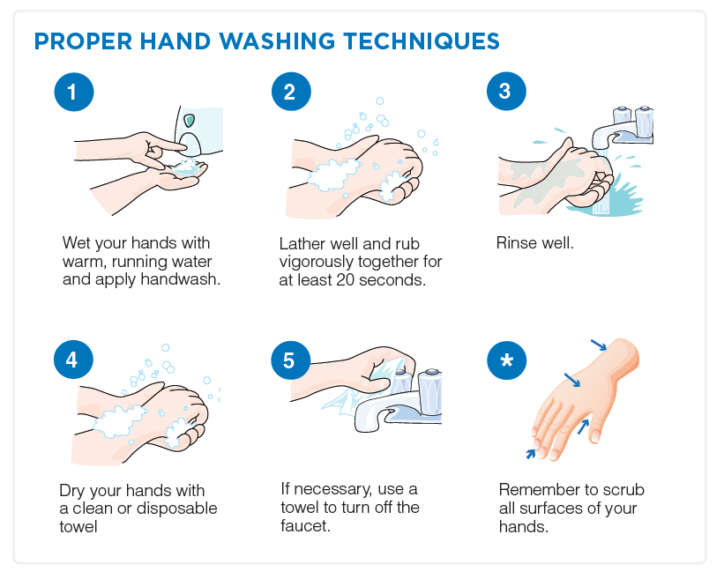
Hand Hygiene
prevention
Since coronavirus infections are primarily spread through person-to-person contact, hand hygiene is a primary part of preventing transmission. Facilities should ensure that personnel are familiar with proper hand hygiene technique as well as its rationale.
Step-by-step procedures on hand washing: Click here to view English version
Handwashing - Clean Hands Save Lives | CDC
www.cdc.gov › handwashing

Slide 7
CDC Guidelines
Handwashing
Handwashing Procedures
Wet your hands with clean, running water (warm or cold), and apply soap
Lather your hands by rubbing them together with the soap. Lather the backs of your hands, between your fingers, and under your nails.
Scrub your hands for at least 20 seconds
Rinse your hands well under clean, running water
Dry your hands using a clean towel or air dry them
Hand Sanitizing Procedures
Apply the product to the palm of one hand (read the label to learn the correct amount)
Rub your hands together
Rub the sanitizer over all the surfaces of your hands and fingers until your hands are dry. This should take around 20 seconds.

Slide 8
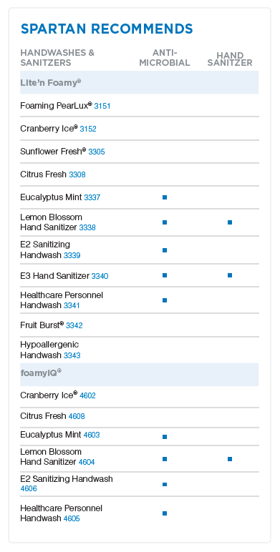
Hand Hygiene
Prevention

Slide 9
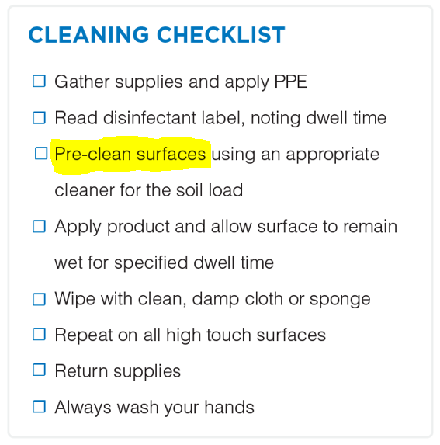
Clean and Disinfect
prevention
Follow your Standard Operating Procedures for Cleaning. If surfaces are soiled with blood or other bodily fluids, please follow the Bloodborne Pathogen Standard.
Select the Right Disinfectant Cleaner and Follow Specific Directions for Use on label
Follow Proper Precautionary Measures (PPE)
Disinfectant/detergent formulations registered by EPA are used for environmental surface cleaning, but the actual physical removal of microorganisms and soil by wiping or scrubbing is probably as important, if not more so, than any antimicrobial effect of the cleaning agent used (taken from the CDC’s HICPAC)

Slide 10
Clean and disinfect
prevention
Front Entrance Door Plate or Handle
Elevator Button Escalator Rail Hand Rail
Door Knob Light Switch Desk Computer
Cafeteria Break Room Appliances
Restroom Fixtures & Toilet

Slide 11
Clean & Disinfect
Prevention
One step cleaner disinfectant:
A one-step cleaner disinfectant has been verified by the EPA to be effective against named organisms in the presence of 5% blood serum solution.
These products generally do not require pre-cleaning in order to disinfect a hard surface as long as dwell time is observed.
However, related to COVID-19, the CDC is recommending a multi-step cleaning process including pre-cleaning prior to disinfection.

Slide 12
Clean & Disinfect
Prevention
Which Spartan Disinfectants kill this Coronavirus?
The EPA has not established any efficacy protocols for surface disinfectants because SARS-CoV-2 is so new.
That said, it is a Coronavirus based syndrome which is an enveloped virus and is considered to be easy to inactivate on non-porous surfaces. The scientific community believes, based on its knowledge of the structure of Coronaviruses, that when an EPA protocol is established the results will show that if your surface disinfectant is effective for other Coronaviruses, such as the Human Coronavirus, it will be effective against the SARS-CoV-2.
The EPA announced that the EPA emerging viral pathogen policy was triggered on January 22, 2020.

Slide 13
Clean & disinfect
Prevention
EPA Emerging Viral Pathogen Policy
Triggered on January 22, 2020.
https://www.epa.gov/pesticide-registration/emerging-viral-pathogen-guidance-antimicrobial-pesticides
Under this policy: Registrants of products with the previously mentioned label amendment and terms of registration would be allowed to use the designated statement in off-label communications intended to inform the user community/public that the disinfectant product(s) may be used against the specific emerging viral pathogen. These off-label statements can inform the public about the utility of these products against the emerging pathogen in the most expeditious manner and can be more easily removed once the outbreak has ended than statements on a label. Note that this document provides general guidance to EPA, pesticide registrants, applicants for pesticide registrations, and the public. This guidance is not binding on EPA or any outside parties, and EPA may depart from the guidance where circumstances warrant and without prior notice.
3/26/2020

Slide 14
Clean & disinfect
Prevention
EPA Emerging Viral Pathogen Policy
Spartan has added the following two statements to marketing literature and promotional materials for BNC-15 and TB-Cide Quat:
BNC-15® (EPA Reg # 6836-348-5741) has demonstrated effectiveness against viruses similar to SARS-CoV-2 on hard, non-porous surfaces. Therefore, BNC-15 can be used against SARS-CoV-2 when used in accordance with the directions for use against Enterovirus D68 and Norovirus (Norwalk virus) hard, non-porous surfaces.
TB-Cide Quat® (EPA Reg # 1839-83-5741) has demonstrated effectiveness against viruses similar to SARS-CoV-2 on hard non-porous surfaces. Therefore, this product can be used against SARS-CoV-2 when used in accordance with the directions for use against Human Rotavirus, Rhinovirus Type 39, Hepatitis A virus, Poliovirus Type 1, and Canine Parvovirus on hard, non-porous surfaces.
Refer to the CDC website https://www.cdc.gov/coronavirus/2019-ncov/index.html for additional information.

Slide 15
Notes:
What is List N: Disinfectants for Use Against SARS-CoV-2
On March 13, 2020 the EPA published List N: Disinfectants for Use Against SARS-CoV-2. List N includes products that meet EPA’s criteria for use against SARS-CoV-2, the cause of COVID-19. This list includes products with emerging viral pathogen claims and those with human coronavirus claims.
https://www.epa.gov/pesticide-registration/list-n-disinfectants-use-against-sars-cov-2

Slide 16
Clean & disinfect
Prevention
Why doesn’t Spartan have any products listed on List N?
This list displays the primary registrant information only.
All supplemental registrations or alternative brand names are not listed. Spartan’s products are marketed and sold under different brand names, but if they have the same EPA registration number, they are the same product
How do I find the EPA registration number on Spartan products?
To find the EPA registration number on Spartan products, look directly below the Active Ingredients listing.
You will see that the registration number for HALT (1018, 4806) is 10324-93-5741. While the Halt brand name is not listed on List N, you will find a match for 10324-93.
The suffix “5741” is Spartan’s EPA establishment number.

Slide 17
Covid-19 resources
prevention

Slide 18
CleanCheck® Training system
prevention
While hand hygiene is the first line of defense against the spread of harmful bacteria such as SARS-CoV-2, disinfection of high touch surfaces helps reduce the risk of personnel coming in contact with a contaminated surface.
To learn more about CleanCheck® Training System, click here!

Slide 19
Compuclean®
prevention
Identifies customer issues and provides solutions
Can be used with customers as well
Quality Assurance
Work Management
Capital Equipment
Inventory Management
To learn more about CompuClean® Training System, click here!

Slide 20
Educational Resources
Covid-19
Spartan Chemical Website – COVID-19 Preparedness
http://www.spartanchemical.com/solutions/covid-19/
The CDC website is the most authoritative source for information concerning disease outbreaks. They coordinate with the EPA and we must be responsible and consistent with their recommendations.
https://www.cdc.gov/coronavirus/2019-ncov/index.html
They have their own FAQ too:
https://www.cdc.gov/coronavirus/2019-ncov/faq.html
This document has all the specifics for “environmental infection control” concerning healthcare and various pathogens including SARS.
https://www.cdc.gov/infectioncontrol/pdf/guidelines/environmental-guidelines-P.pdf
Novel Coronavirus, or COVID-19, cleaning falls under the Bloodborne Pathogen Standard and should be considered when making recommendations.
https://www.osha.gov/pls/oshaweb/owadisp.show_document?p_id=10051&p_table=STANDARDS
Pandemic Preparedness Resources – CDC
https://www.cdc.gov/coronavirus/2019-ncov/php/pandemic-preparedness-resources.html

Slide 21
Educational Resources
COVID-19
Food Safety and the Coronavirus Disease 2019 (COVID-19)
https://www.fda.gov/food/food-safety-during-emergencies/food-safety-and-coronavirus-disease-2019-covid-19
National Restaurant Association Coronavirus Information and Resources
https://www.restaurant.org/Covid19
Interim Guidance on Management of Coronavirus Disease 2019 (COVID-19) in Correctional and Detention Facilities
https://www.cdc.gov/coronavirus/2019-ncov/community/correction-detention/guidance-correctional-detention.html
Coronavirus: Prevention and Control for the Cleaning Industry
https://www.issa.com/education/cleaning-for-infection-prevention/coronavirus-prevention-and-control-for-the-cleaning-industry
Infection Control and Laundry
https://www.spartanchemical.com/globalassets/solutions/covid-19/infection-control-and-laundry.pdf

Slide 22
summary
COVID-19
A managed cleaning program is the most effective weapon against the spread of viruses.
Hand washing and sanitizing solutions are your first line of defense against the spread of pathogens.
Facility managers need to ensure that HTPs (High Touch Points) are being properly cleaned and disinfected.
Effective cleaners and disinfectants break the cycle of infection on high-touch surfaces.
Training and education tools ensure safety, professionalism, and compliance.

Slide 23
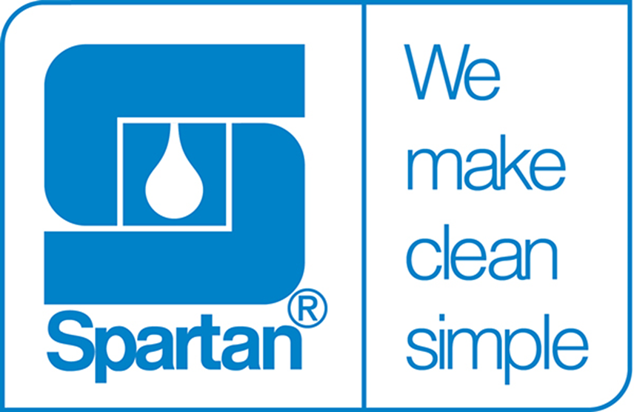
Thank you

